Slide 1
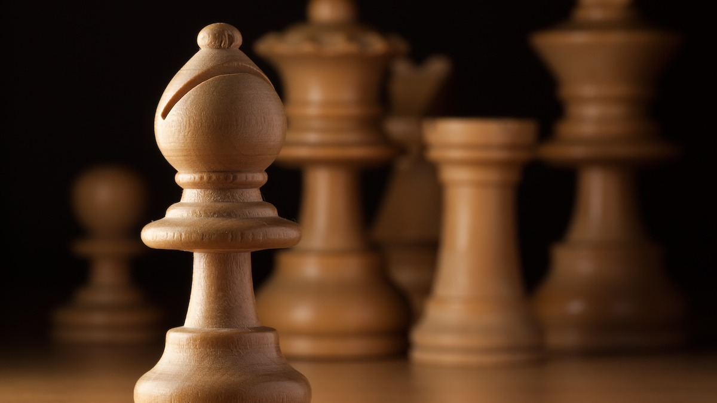
Chess Positions

Slide 2
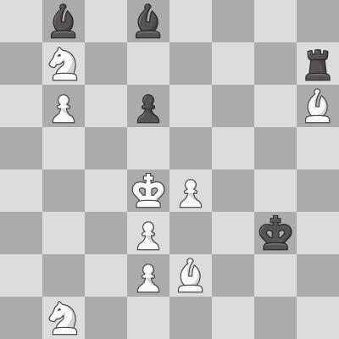
The Data
1b1b4-1N5r-1P1p3B-8-3KP3-3P2k1-3PB3-1N6.jpeg
100,000 randomly generated images
The position is encoded in the filename in FEN notation
There are 32 different piece sets and 28 different board styles.

Slide 3
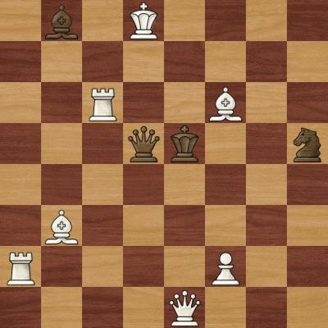
The problem
1b1K4-8-2R2B2-3qk2n-8-1B6-R4P2-4Q3.jpeg
There are 896 different board-piece combinations making categorization difficult
1.96 * 10^71 different board states making categorization absolutely impossible

Slide 4
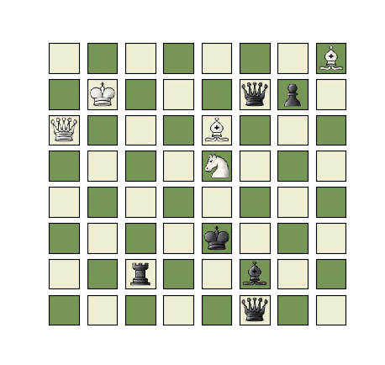
The Solution
Divide the board into 64 squares
Each Square has only 13 categories to predict
As long as the FEN code is put aside for now this is perfectly manageable with a CNN

Slide 5
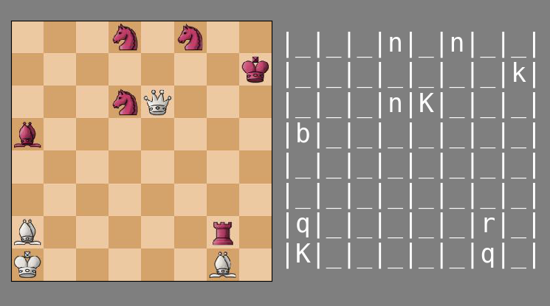
Setting up the CNN
Accuracy of 92.34% per square
.9234 ^ 64 % = 0.61% per board
One Conv2D layer with ReLU
One Flattened Dense layer with softmax
Trained with 80 random boards
Validated 20 random boards
Tested with 100 random boards from the hold out

Slide 6
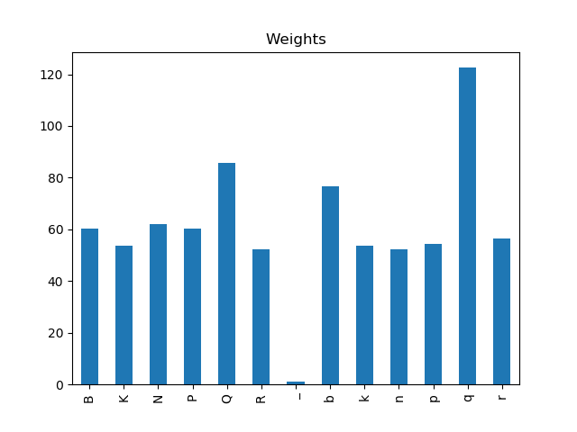
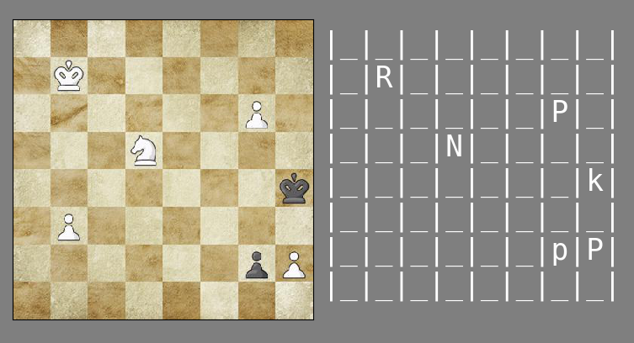
Weights
Weights are calculated per training set
94.59% Accuracy per square
.9459 ^ 64 = 2.84% per board

Slide 7
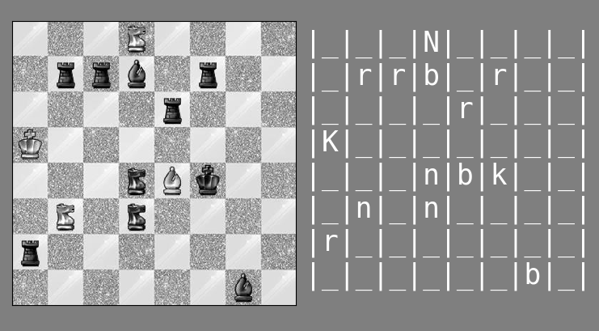
Grey scale
98.36 % Accuracy per square
.9836 ^ 64 = 34.70% per board

Slide 8
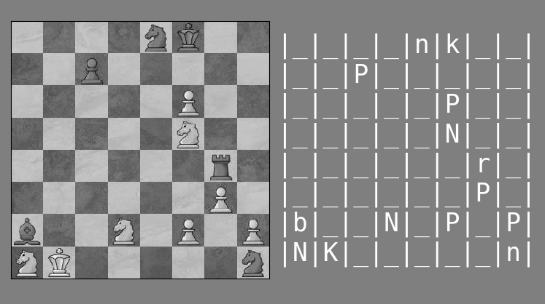
Scale it up
99.98% accuracy per square
.9998 ^ 64 = 98.73% per board
Looped current fit module 20 times letting it train on 1600 boards
Tested with 100 random boards from the hold out set
Only one error in the entire test set!

Slide 9
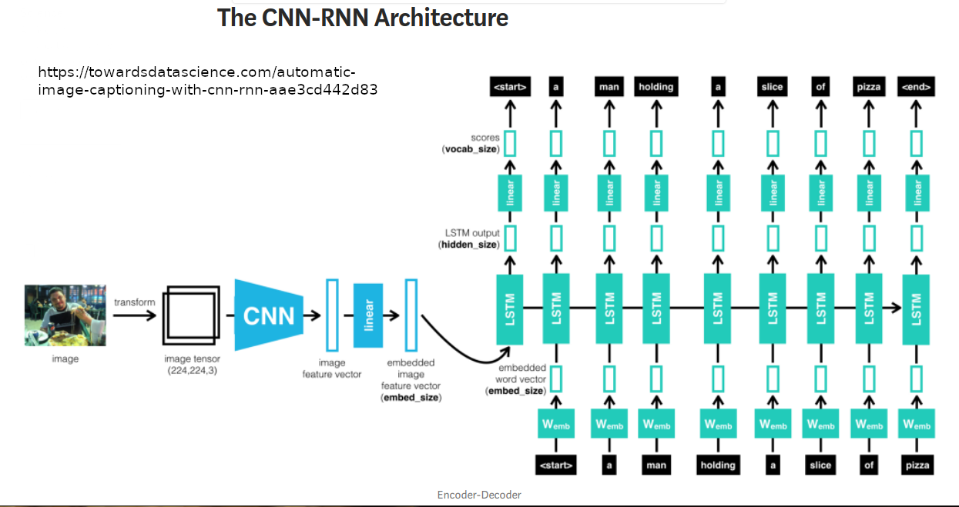
Moving Forward
Predicting FEN notation
There is a model used to predict captions on pictures which could be useful to predict the FEN notation directly from the whole image.

Slide 10
Chess Positions

